Slide 1
dbachecks! DBA Checklists: Reliable, Repeatable, & Automated
Patrick Flynn | Link Group Australia

Slide 2
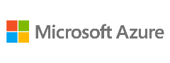







Please Thank & Support our Sponsors
SQL Saturday is made possible with the generous support of these sponsors. You can support them by opting-in and visiting them in the sponsor area.
Global Alliance Partner:
Venue & Internet Sponsor:
Silver Sponsor:
Operations Support:
Endless Support from:
OGMA Consulting Corp.
Bronze Sponsor:

Slide 3

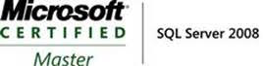


Patrick Flynn SQL Server DBA Link Group Australia Group
MCM – SQL Server 2008
MCSM – Data Platform
Production DBA for 10+ years.
Contibutor to dbatools
Regular speaker as SqlSaturday events around world.
All Presentations available at:
https://github.com/sqllensman/Presentations
sqlsaturday@sqllensman.com
@sqllensman
Patrick Flynn

Slide 4
Agenda:
Background
Goals and Challenges
Solution
Demo

Slide 5
Background
Notes:
Arose from need to evaluate
By Instance,

Slide 6
As a SQL DBA you want to know that your SQL Server Estate is compliant with the rules that you have set up. Now there is a simple method to set this up using PowerShell and you can get the results in PowerBi or a report emailed to you on a schedule. Details such as How long since your last backup? How long since your last DBCC Check? Are your Agent Operators Correct? Is AutoClose, AutoShrink, Auto Update Stats set up correctly? Is DAC Allowed? Are your file growth settings correct, what about the number of VLFs? Is your latency, TCP Port, PS remoting as you expect? Is Page Verify, Data Purity, Compression correctly set up? and many more checks (even your own) can be achieved using the dbachecks PowerShell module brought to you by the dbatools team.

Slide 7
Notes:
Checklists are for everyone
What do Johns Hopkins surgeons, anonymous big-time investors and Pilots have in common? This isn’t the set up for a terrible joke but a demonstration of how widespread an often-overlooked tool is – they all use checklists to avoid disaster.
The Checklist Manifesto, written by writer/surgeon Atul Gawande, is proof that checklists really work.

Slide 8
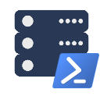
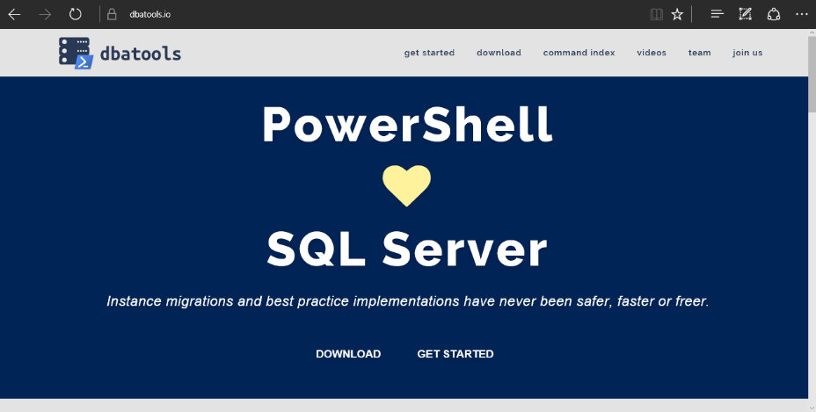
dbatools
dbatools is a free PowerShell module with over 300 SQL Server best practice, administration and migration commands included.
Notes:
Community project, initially started out as Start-SqlMigration but has grown into a DBA’s best friend. dbatools currently sports 390+ commands.

Slide 10
What is Pester:
Test Runner for PowerShell
A Unit Testing Framework
An Infrastructure Testing Framework
Comes pre-installed with Windows.
Notes:
https://www.youtube.com/watch?v=lNCR5yLSwi0 -- Test your Powershell with Pester and PSScriptAnalyzer
“Untested Code is Broken Code”
Infrastructure Testing with Pester - https://www.youtube.com/watch?v=zSEK74_fsLw
Pester is a unit-testing framework for PowerShell, and perhaps the first open-source software product that ships with Windows itself!
Author Adam Bertram will walk you through the Pester philosophy, syntax, and numerous real-world examples in this "Agile-published" book.
The Pester Book
https://leanpub.com/creatinghtmlreportsinwindowspowershell
https://leanpub.com/powershell-scripting-toolmaking
https://leanpub.com/pesterbook

Slide 11
Goals and Challenges

Slide 12
Our Goal
Create redistributable, easily configurable Pester tests using industry leaders checklists
Enable output to suit the requirements of different types of end users human and machine

Slide 13
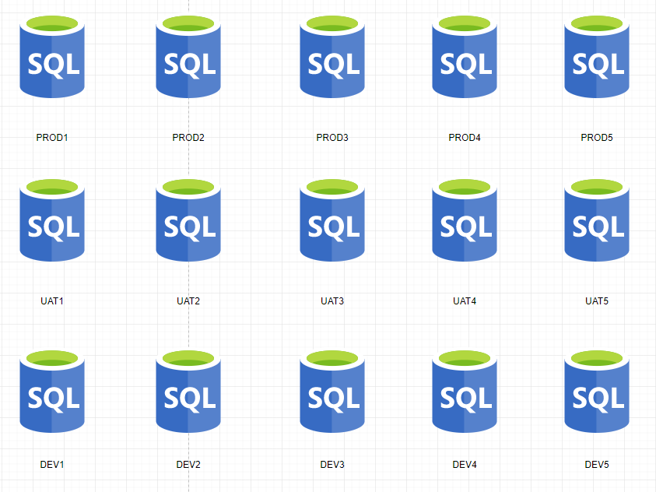
Consider Your SQL Environment

Slide 14
Consider Your SQL Environment
PRODUCTION
No SA account
Backup Compression
FULL Recovery
Secure Backup Location
Agent Alerts
Production Agent Jobs
Only Certain Production AD Groups allowed
And much more

Slide 15
Consider Your SQL Environment
TEST
Different Backup Strategy
Test Agent Jobs
Needs the Testers AD Groups
And much more

Slide 16
Consider Your SQL Environment
Development
Simple Recovery
No Agent Jobs
Definitely no Production AD Information
SA Account
And much more

Slide 17
Consider Your SQL Environment
Widget One
Global view of one ‘widgets’ environments might be needed for
Project Managers
Team Leaders
Release Managers
Agile Teams

Slide 18
Consider Your SQL Environment
Special Snowflakes
For those ‘special’ SQL Servers that don’t fit in the usual boxes
I.E. SharePoint

Slide 19
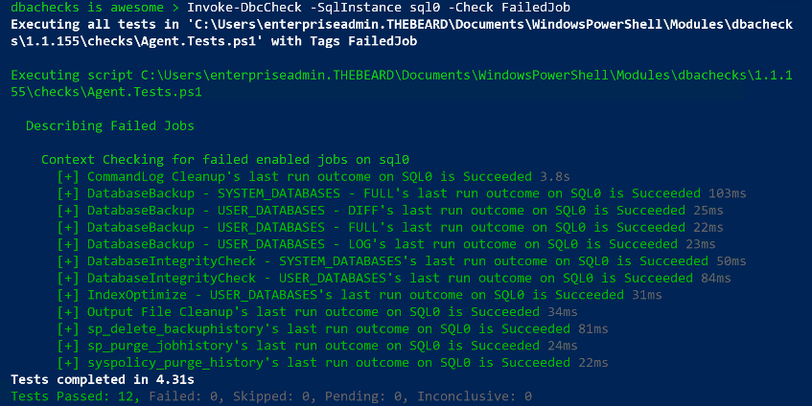
Challenge - Output
DBAs may need output instantly

Slide 20
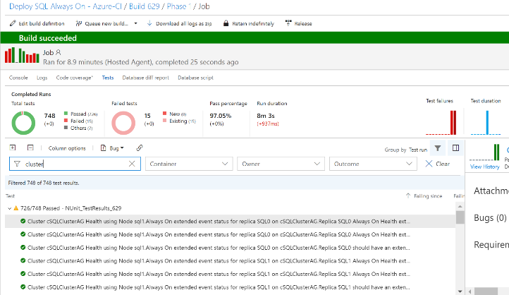
Challenge - Output
DBAs may want to automate and integrate with other solutions (DevOps, Daily Checks, Incident Response, Maintenance Windows)

Slide 21
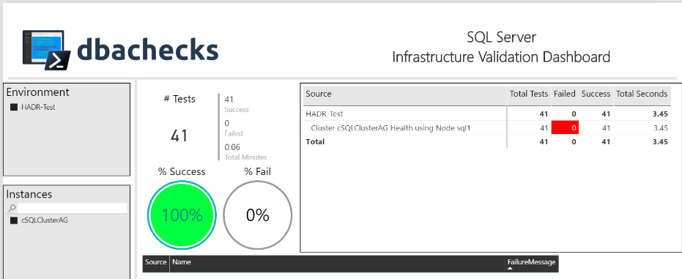
Challenge - Output
Management want output they understand
– (and with pretty interactive pictures !)

Slide 22
Challenge - User Simplicity
End Users
Need simplicity to enable easy adoption
Need index for Checks
Need index for Configuration
Simplified output options
File system access to work across many differing user environments and permissions

Slide 23

Solution

Slide 24
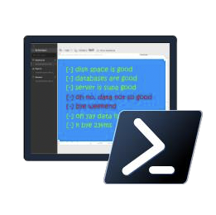
dbachecks

Slide 25
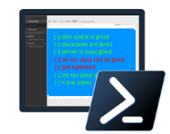
dbachecks
dbachecks is a framework created by and for SQL Server pros who need to validate their environments.
This open source module allows us to crowdsource our checklists using Pester tests.
Such checks include:
Backups are being performed
Identity columns are not about to max out
Servers have access to backup paths
Database integrity checks are being performed and corruption does not exist
Disk space is not about to run out
All enabled jobs have succeeded
Notes:
Basically, we all share similar checklists and mostly just the server names and RPO/RTO/etc change.

Slide 26
System Requirements
Recommended
Minimum
Client
PowerShell v4
Modules
dbatools
Pester
PSFramework
Client
PowerShell v5.1
Server
Everything dbatools supports
From SQL2000 to SQL vNext

Slide 27

Extensive documentation within each command
PS > Get-Help Invoke-DbcCheck –Detailed
Photo by Ian Espinosa on Unsplash

Slide 28
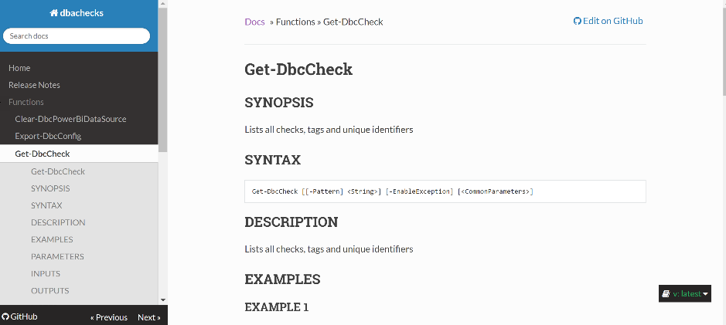
Documentation for each command online
dbachecks.readthedocs.io

Slide 29
Dbachecks – User Simplicity
Simple Execution
Invoke-DbcCheck

Slide 30
Dbachecks – User Simplicity
Simplified Output
Update-DbcPowerBiDataSource
Start-DbcPowerBi

Slide 31
Dbachecks – User Simplicity
Simple Indexing Commands
Get-DbcCheck
Get-DbcConfig
Get-DbcTagCollection

Slide 32
Dbachecks – Configuration
Using PSFramework to create configuration items
Over 120 configuration items available right now (May 2018)
Enabling Users to set configuration
Set-DbcConfig -Name app.sqlinstance -Value sql2016, sql2017
Set-DbcConfig -Name app.sqlinstance -Value sqlcluster –Append

Slide 33
Dbachecks – Configuration
Stored in registry
Export and Import the config
Export-DbcConfig -Path C:\Users\Beard\git\PesterConfigs\Application1_PROD.json
Export-DbcConfig -Path C:\Users\Hair\git\PesterConfigs\Client1_System2_Quick.json
Import-DbcConfig -Path Git:\PesterConfigs\Application1_PROD.json
Invoke-DbcCheck
Import-DbcConfig -Path Git:\PesterConfigs\Client1_System2_Quick.json
Invoke-DbcCheck

Slide 34
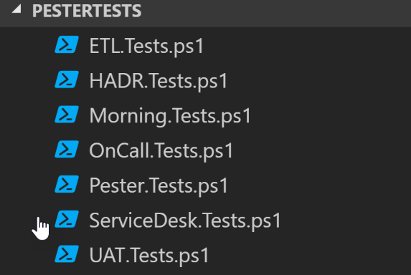
Got your own Checks?
Set-DbcConfig –Name app.checkrepos –Value ‘Path To PesterTests’ -Append

Slide 35
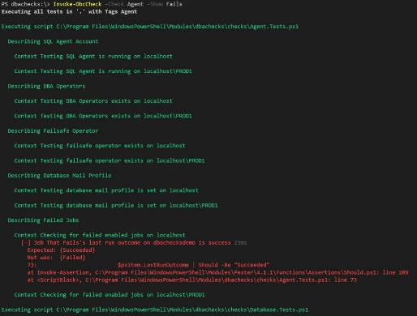
Dbachecks – Output
Invoke-DbcCheck wraps Invoke-Pester so
results available at command line

Slide 36
Dbachecks – Output
Invoke-DbcCheck can output XML (same as Invoke-Pester )
Import-DbcConfig -Path $(System.WorkingDirectory)\PesterConfigs\Application.json
Invoke-DbcCheck -Show Summary -PassThru -OutputFile $(System.WorkingDirectory)\Test-Results.xml
Notes:
Alllows results to be integrated with other systems

Slide 37
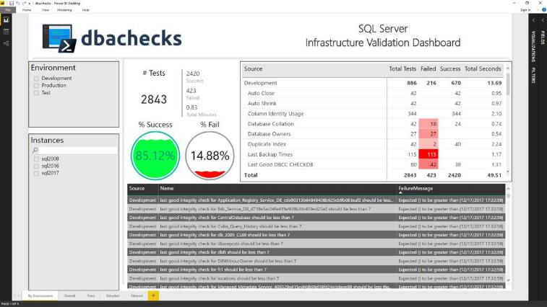
Dbachecks – Output
Output Data as PowerBI Dashboard Report

Slide 38

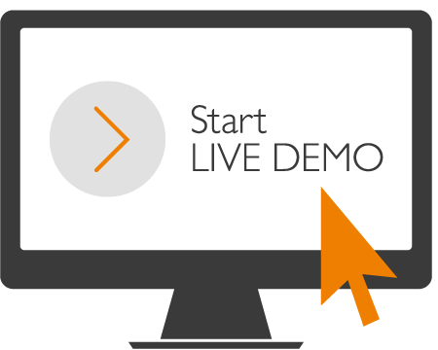
Notes:
Demo’s of Backup Script
Maintenance Plans Ola Hallengren
Minion Backup

Slide 39
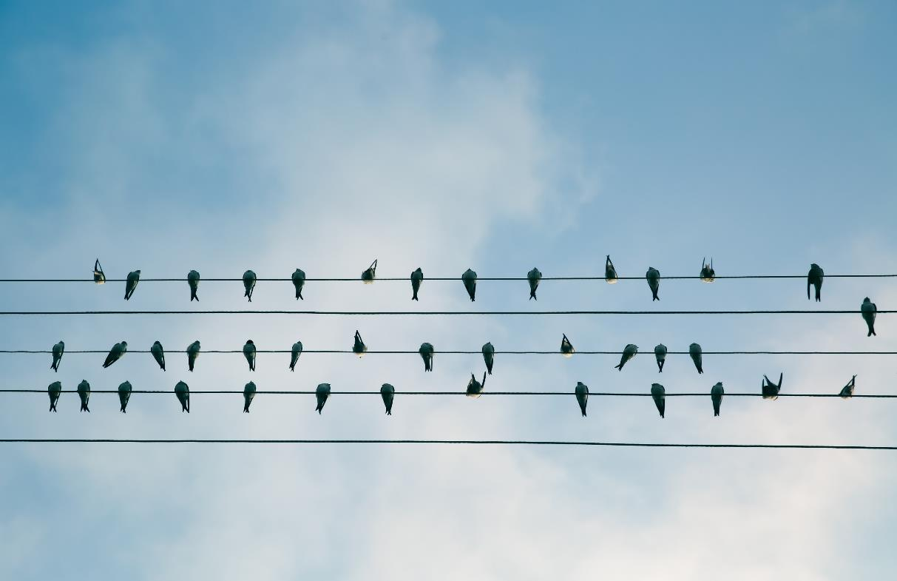
Installation on a connected machine
Photo by Slava Bowman on Unsplash

Slide 40
Installation on a connected machine
PS > Install-Module dbachecks
PS > Install-Module dbachecks –Scope CurrentUser
Photo by Slava Bowman on Unsplash

Slide 41
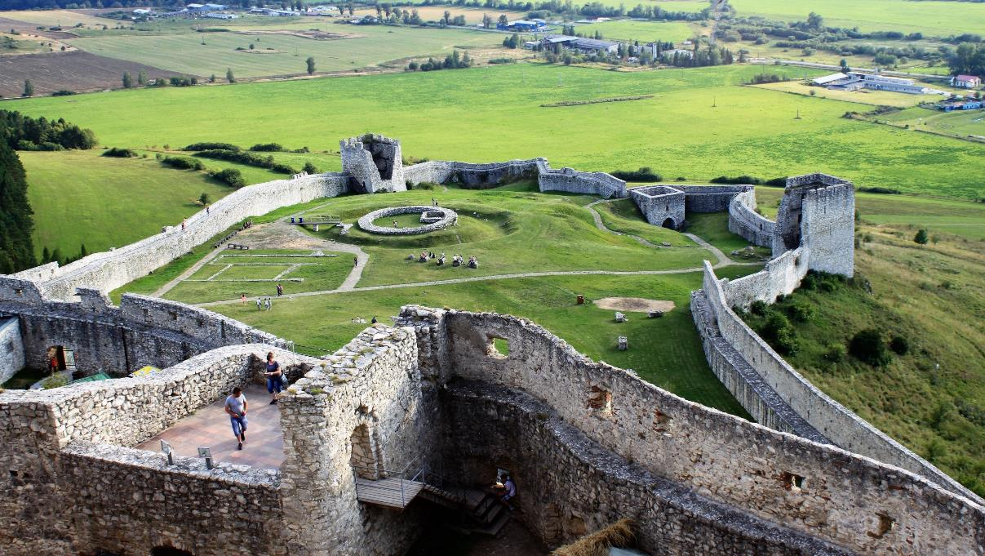
Installation in a fortress
Photo by Klára Koszeghyova on Unsplash

Slide 42
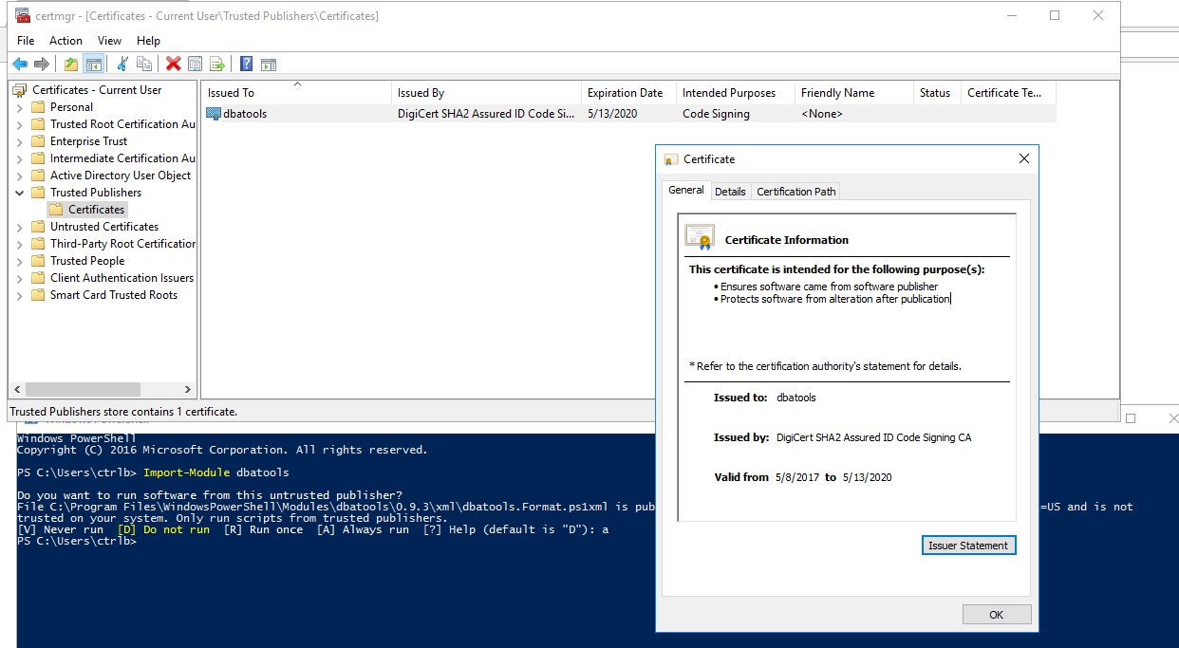
Whilst we are talking about security

Slide 43
Installation in a fortress
PS > Save-Module dbachecks –Path C:\SomeDirectory
PS > Save-Module Pester –Path C:\SomeDirectory
PS > Save-Module dbatools –Path C:\SomeDirectory
PS > Save-Module PSFramework –Path C:\SomeDirectory
Photo by Klára Koszeghyova on Unsplash

Slide 44
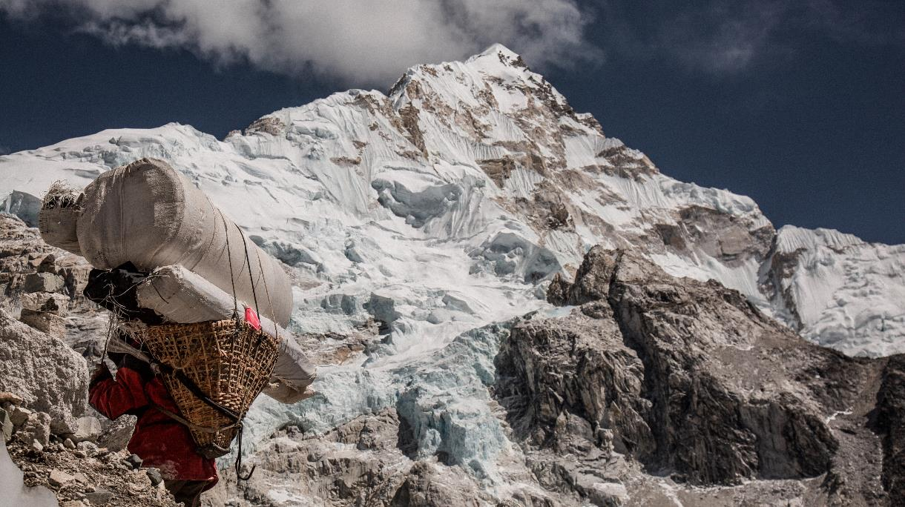
Installation in a fortress
Photo by Christopher Burns on Unsplash
Notes:
You have to find a way to transport it to the fortress

Slide 45

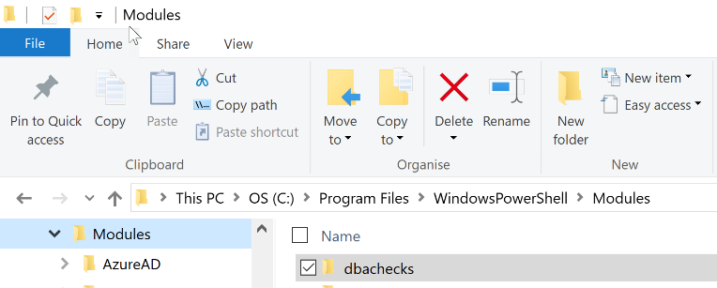
Installation in a fortress
For Everyone
Photo by Christopher Burns on Unsplash

Slide 46

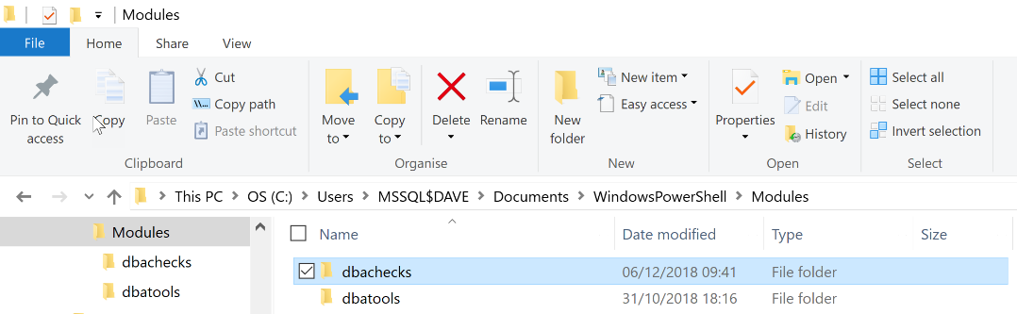
Installation in a fortress
There Can Be Only One
Photo by Deglee Degi on Unsplash

Slide 47
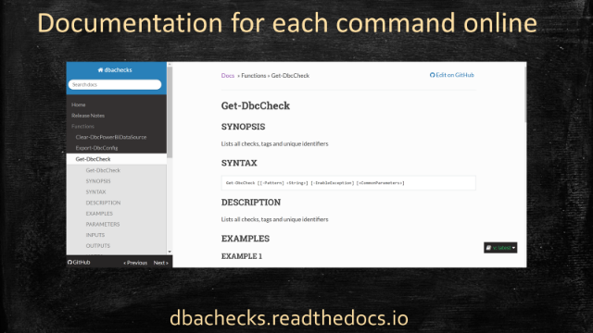
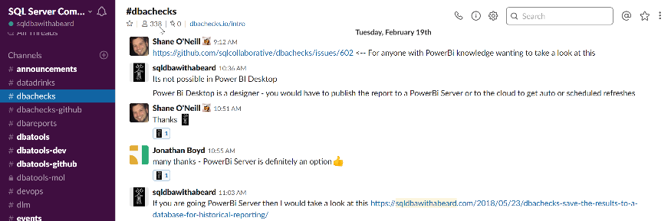
Open Source but there is support
dbatools.io/slack

Slide 48
Social
Make sure you tweet on #SQLSat828 or #SQLSatVictoria
Don’t forget to thank Volunteers and other Speakers!

Slide 49
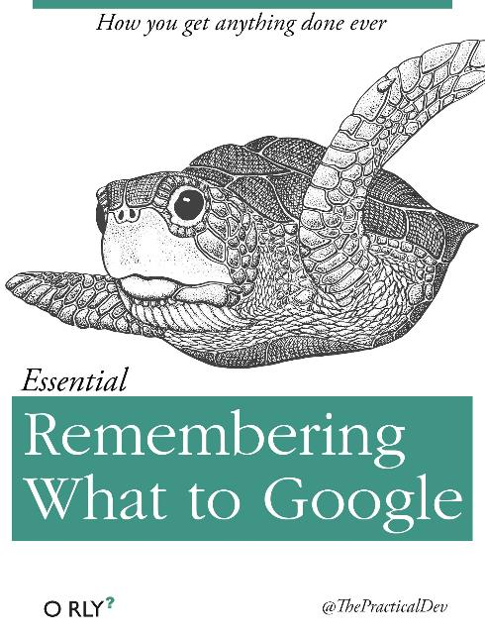

Slide 50
dbachecks Links
Announcing dbachecks – Configurable PowerShell Validation For Your SQL Instances by Rob Sewell
introducing dbachecks - a new module from the dbatools team! by Chrissy LeMaire
install dbachecks by Chrissy LeMaire
dbachecks commands by Chrissy LeMaire
dbachecks – Using Power BI dashboards to analyse results by Cláudio Silva
My wrapper for dbachecks by Tony Wilhelm
Checking backups with dbachecks by Jess Promfret
dbachecks please! by Garry Bargsley
dbachecks – Configuration Deep Dive by Rob Sewell
Test Log Shipping with dbachecks
Checking your backup strategy with dbachecks by Joshua Corrick
Adding your own checks to dbachecks by Shane O'Neill
dbachecks - A different approach for an in-progress and incremental validation by Cláudio Silva

Slide 51


Slide 52


